Slide 1
Marine Leader Development (MLD): Establishing a Unit Leadership Development Program
January 2018
Lejeune Leadership Institute

Slide 2
Agenda
Deliberate Planning
Problem Framing
Leadership Resources
MLD References
MLD Program Lines of Effort (LOE)
LLI Contact Info

Slide 3
Deliberate Planning
Develop a plan to plan your unit’s Marine Leader Development program
Recommend using MCPP, MCWP 5-10 (problem framing brief)
If you are assigned to develop your unit’s MLD program and not part of the S3, go consult the S3A, Ops Chief, or Ops O about developing your plan to plan
Do the work to orient your planning team before the problem framing brief with your planning timeline, references, and expectations for staff estimates
Provide your OPT with the references to prepare for your problem framing brief, i.e. the MLD Order 1500.61, MCRP 6-10A Sustaining the Transformation, MCDP-1 Warfighting, MCWP 6-10 Leading Marines, Marine Corps Order No. 29, Unit Training Plan, etc.
Seek your commander’s initial guidance. This is most likely in your unit’s training plan. Remember, the commander is a key member in the planning process.

Slide 4
Problem Framing
Commander’s Orientation- “first of many venues where the commander, his staff, and subordinate commanders collaborate through the exchange of information and the sharing of ideas and perspectives. Accordingly, the commander’s orientation is the initial step in the design effort to begin to frame the problem as a basis for developing possible solutions”. MCP 5-10
Understand the Problem- “The essential activities in understanding the problem continue to be critical thinking and an open, frank dialogue to help reveal the underlying nature of the problem. In this manner, commanders use their understanding of the problem to formulate their intent and guidance”.
Commander’s Initial Intent and Guidance- “Having engaged in a design dialogue with his planners and staff in order to gain insight into the problem, the commander provides his initial intent and guidance in order to direct continued actions in the planning process”.
Analyze Tasks- “Commands normally receive tasks that planners analyze as a basis for determining the unit’s mission. The principal source for tasks is the HHQ plan or order, but there may be other sources, such as verbal guidance, from which to derive tasks”.
Specified – “primarily from the execution paragraphs of the HHQ OPORD”
Implied – “Implied tasks are not specifically stated in the HHQ order, but they are necessary to accomplish specified tasks”
Essential – “Essential tasks are specified or implied tasks that define mission success and apply to the force as a whole”
Chapter 2, MCWP 5-10

Slide 5
Leadership Resources
HITT
Unit PME Site
Marine Leadership
Development website
MARINE CORPS
BASE/STATION
MCMAP
Instructors
Former
Recruiters
“Key Leaders”
UNIT
Personal
Finance
Managers
MCFLCs
WEB-BASED
The Best Leadership Resources are on the Morning Report
Notes:
5
5

Slide 6
MLD References
MLD Order, MCO 1500.61, https://www.usmcu.edu/sites/default/files/LLI/MCLD/MCO%201500.61.pdf
Marine Corps Order No. 29, https://www.usmcu.edu/sites/default/files/LLI/MCLD/Fidelity/Relations%20Between%20Officers%20and%20Men.pdf
MCDP-1 Warfighting, https://www.usmcu.edu/sites/default/files/LLI/MCLD/Fidelity/Sustaining%20the%20Transformation%20MCTP%206-10A.pdf
MCWP 5-10 Marine Corps Planning Process, http://www.marines.mil/Portals/59/Publications/MCWP%205-10%20FRMLY%20MCWP%205-1.pdf?ver=2017-08-28-140131-227
MCWP 6-10 Leading Marines, https://www.usmcu.edu/sites/default/files/LLI/MCLD/Fidelity/Leading%20Marines%20MCWP%206-10.pdf
MCRP 6-10A Sustaining the Transformation, https://www.usmcu.edu/sites/default/files/LLI/MCLD/Fidelity/Sustaining%20the%20Transformation%20MCTP%206-10A.pdf
Six Fs, https://www.usmcu.edu/lli/marine-leader-development

Slide 7
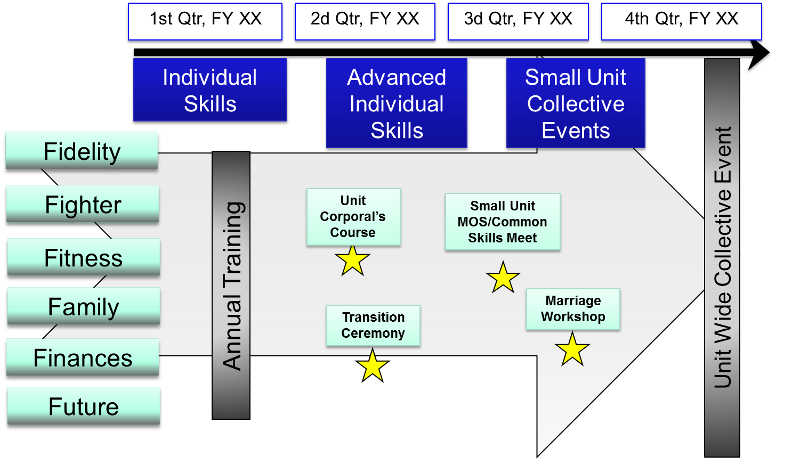
MLD Lines of Effort
Notional Training Plan
1st Qtr, FY XX
2d Qtr, FY XX
3d Qtr, FY XX
4th Qtr, FY XX
Individual Skills
Advanced Individual Skills
Small Unit Collective Events
Fidelity
Fighter
Unit Corporal’s Course
Small Unit MOS/Common Skills Meet
Fitness
Unit Wide Collective Event
Annual Training
Family
Marriage Workshop
Transition Ceremony
Finances
Future

Slide 8
Leadership Doctrine (703).784.9753 (703).432.5519
https://www.usmcu.edu/mld-establish-ldp/
Notes:
8
8

